Slide 1

UMS presentation slides

Slide 2
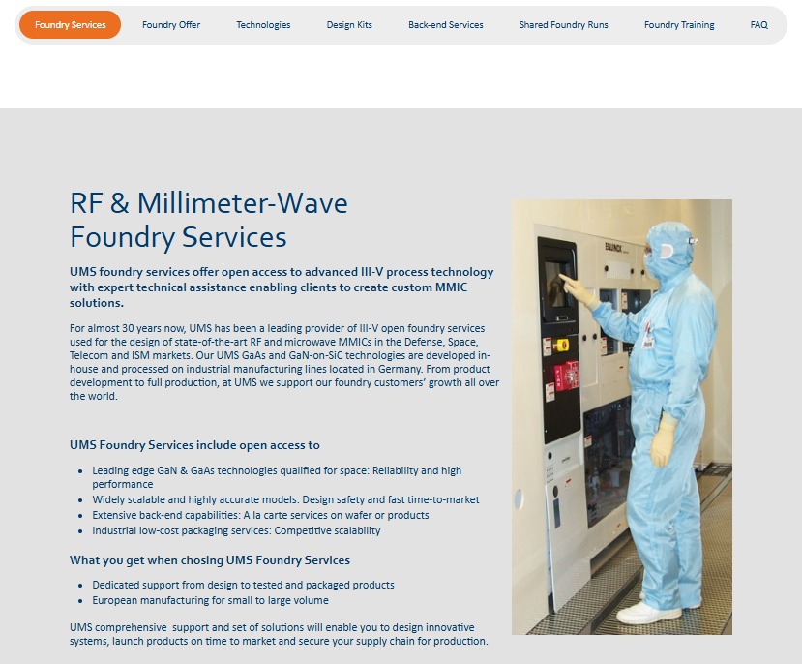

Slide 3
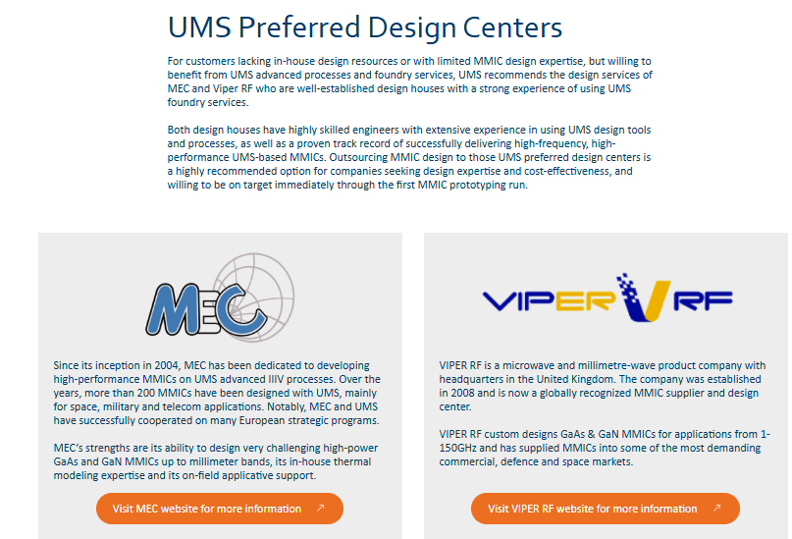

Slide 4

https://www.ums-rf.com/shared-foundry-runs/

Slide 5
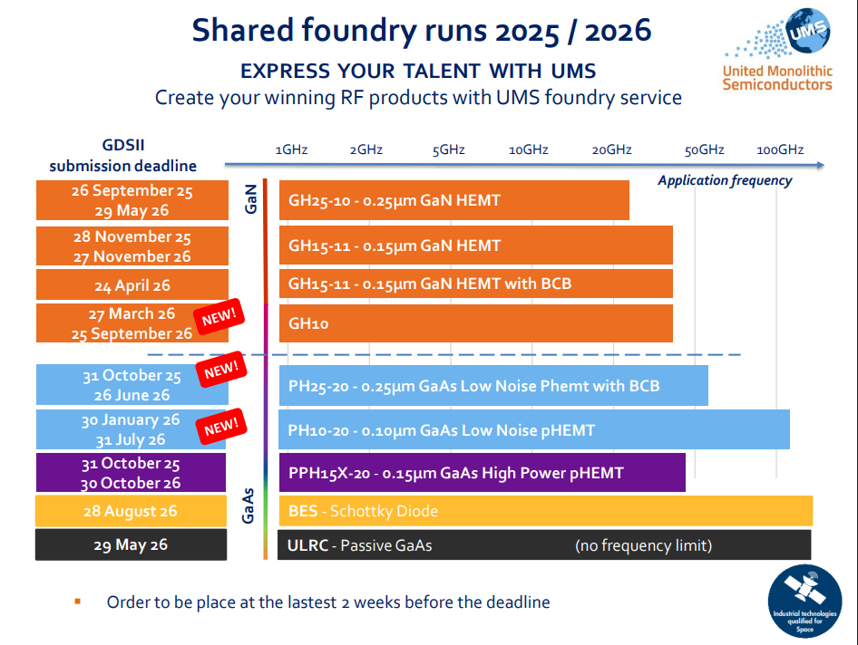

Slide 6
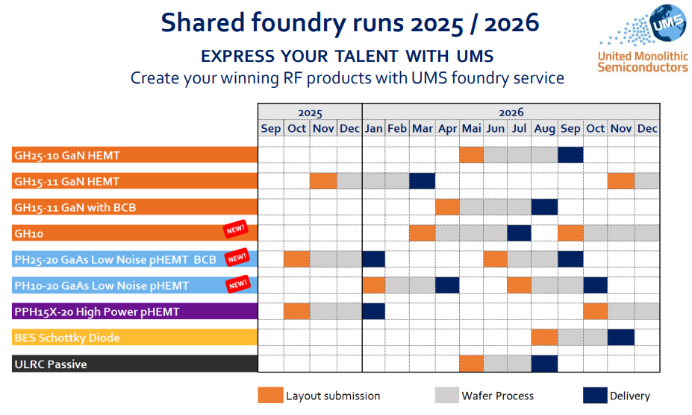
Assume that
Similar Fab
Schedule is
Available for 2026/2027
Potential submission
windows compatible with
MS Thesis Program that
would start in Fall Semester
with a mid-Spring Semester
design submission date.
The completed Integrated
Circuits would arrive for
device characterization in
the Fall Quarter. Choose
Fabrication dates that
Allow for summer fab
Schedule!
https://www.ums-rf.com
/wp-content/uploads/2025/11/
MPW-Planning-2025-2026.pdf
Cal Poly M.S. student
IC Design, layout and.
design rule check period
IC Fabrication
At UMS and Test
Design at Cal Poly
IC Test
And Thesis

Slide 7
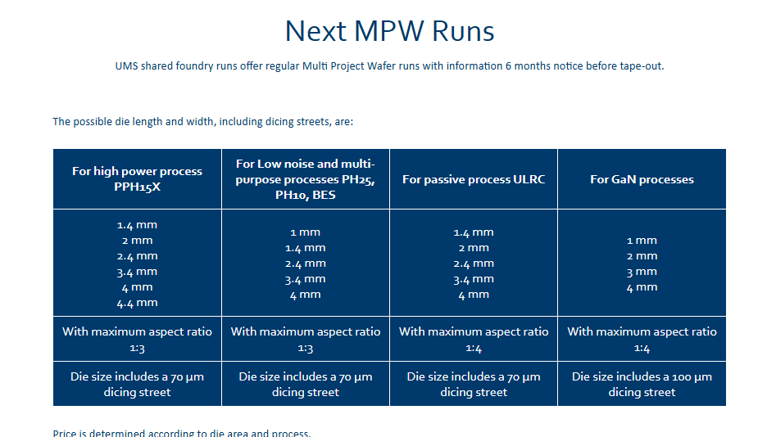

Slide 8
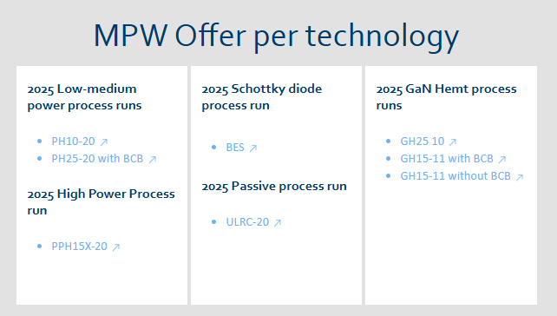

Slide 9
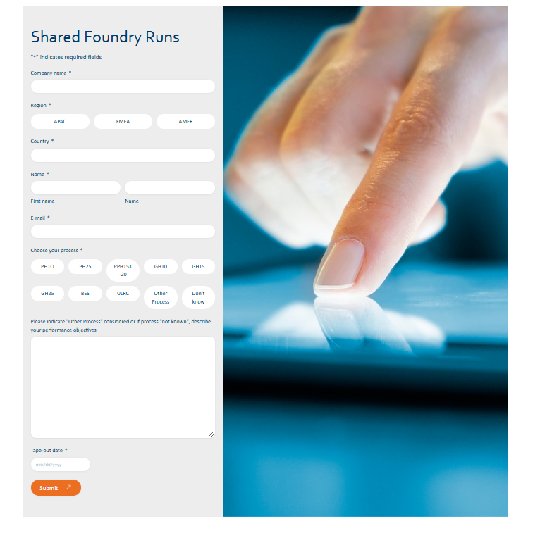

Slide 10
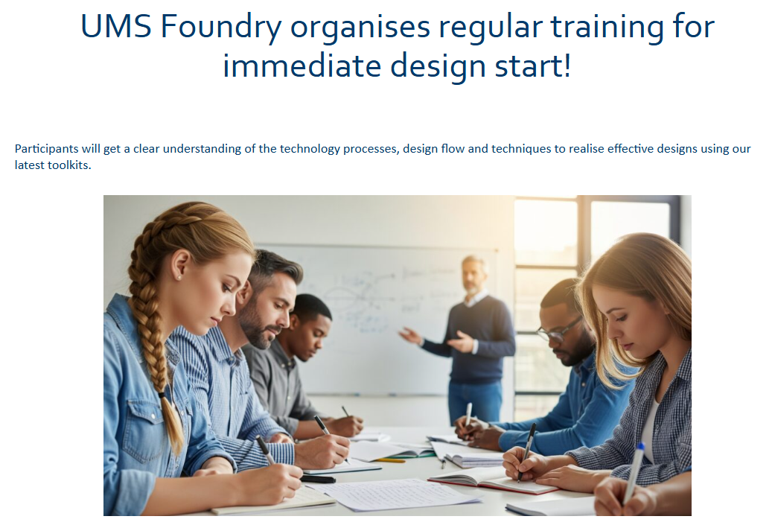

Slide 11
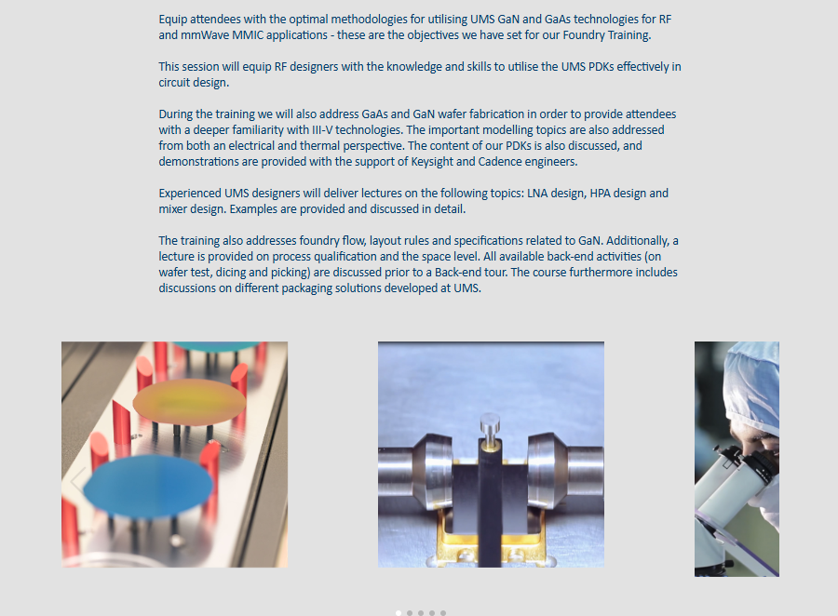

Slide 12
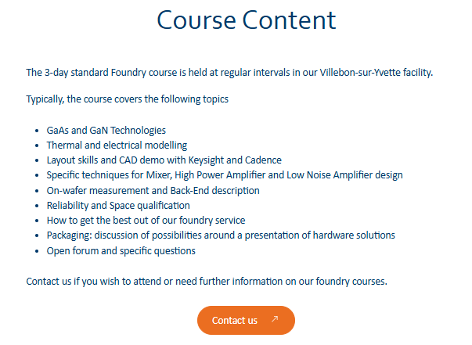

Slide 13
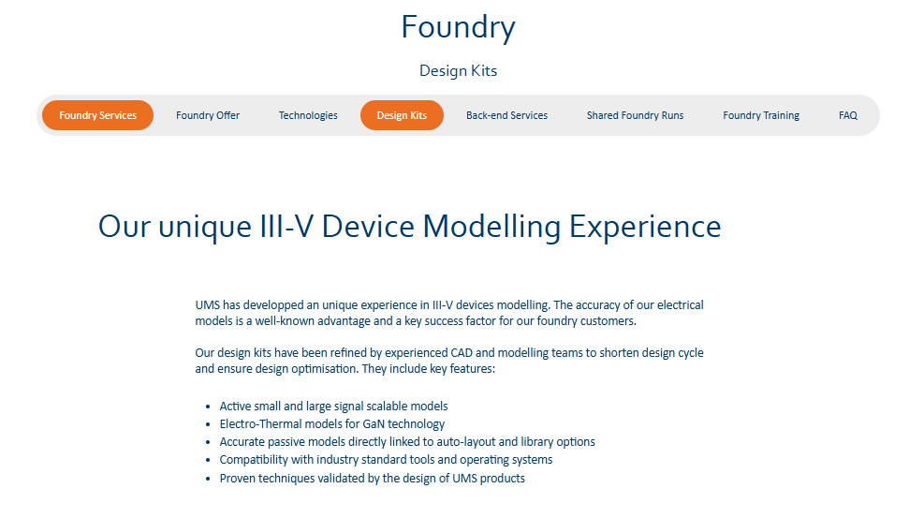

Slide 14
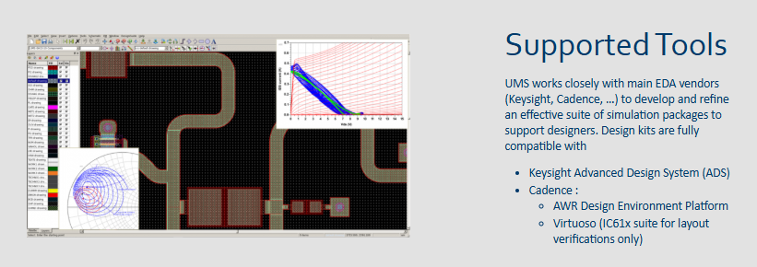

Slide 15
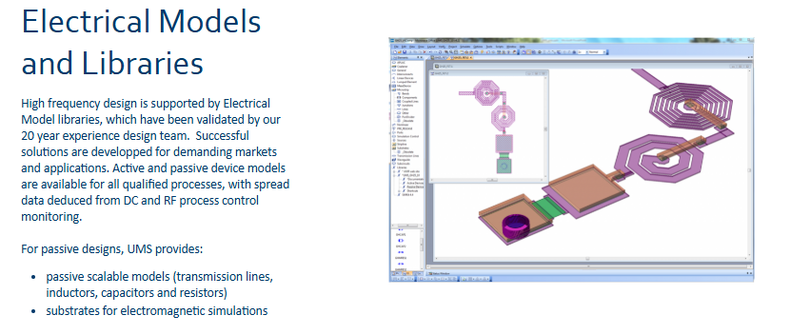

Slide 16
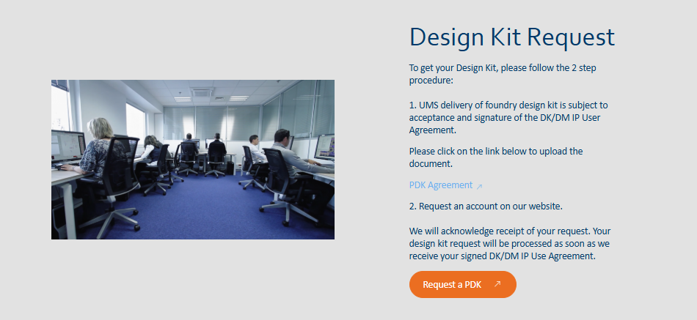

Slide 17
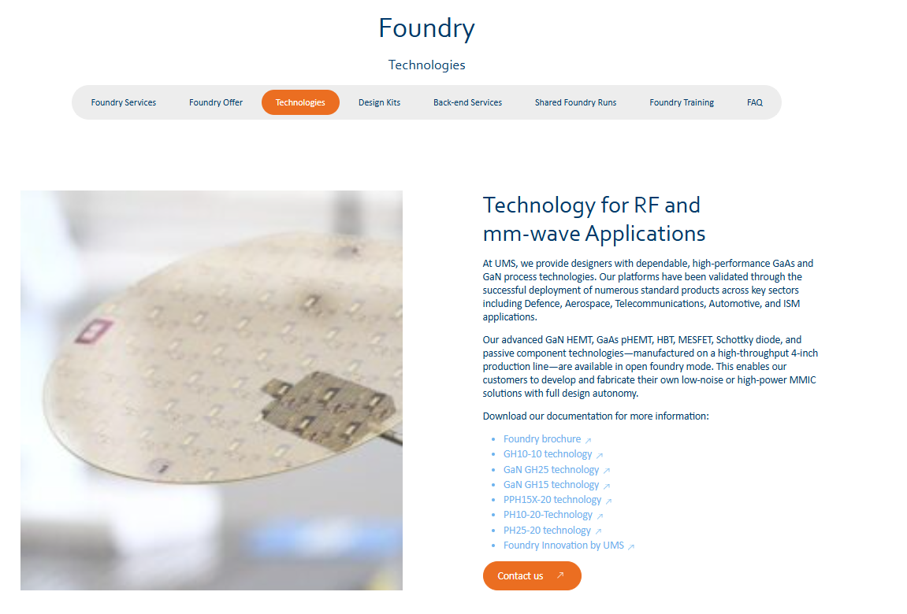

Slide 18
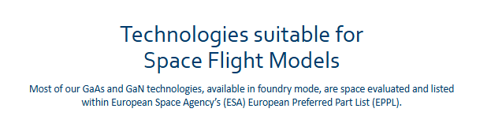

Slide 19
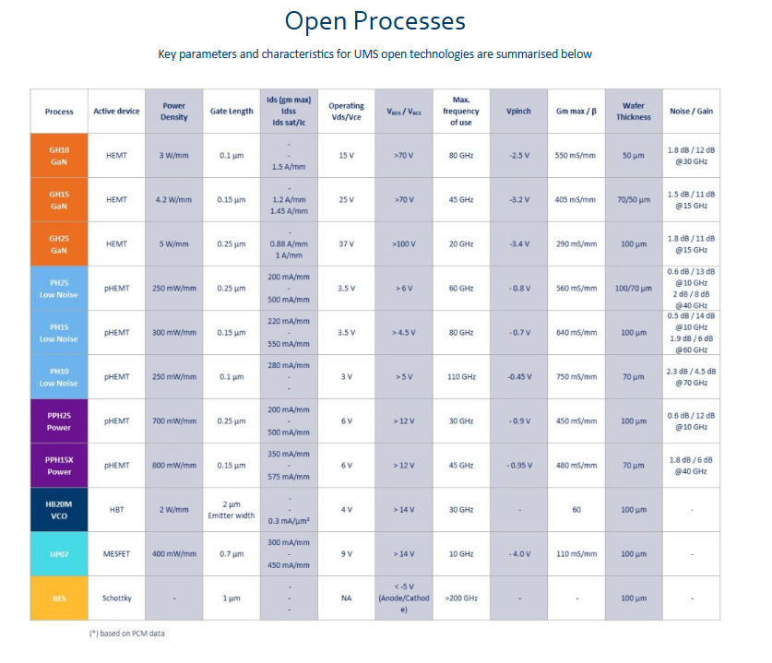

Slide 20
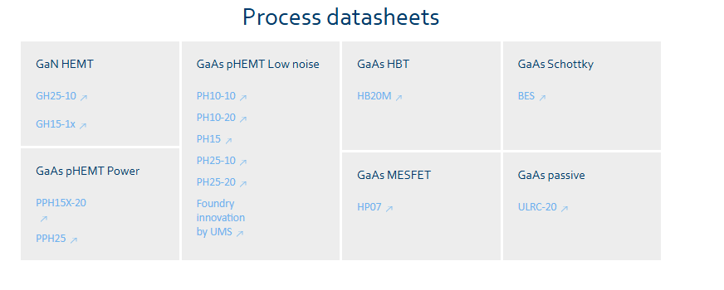

Slide 21
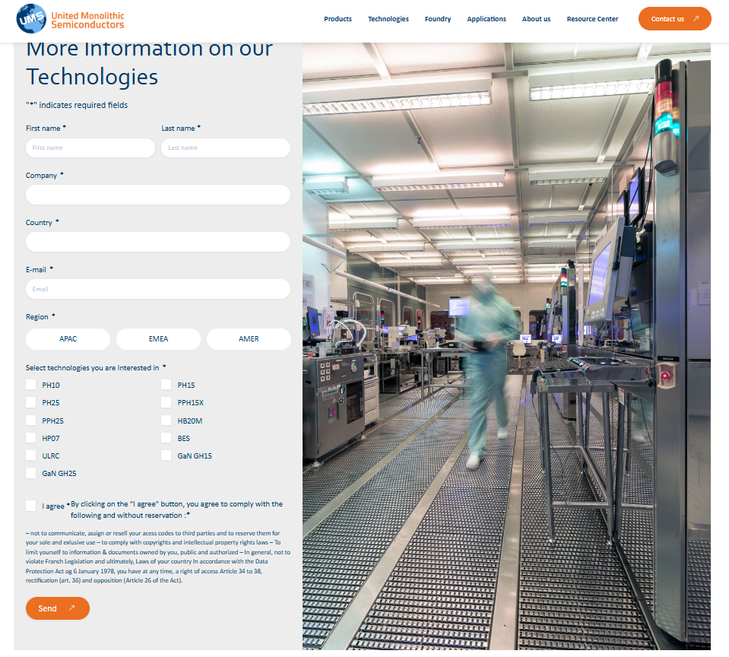

Slide 22
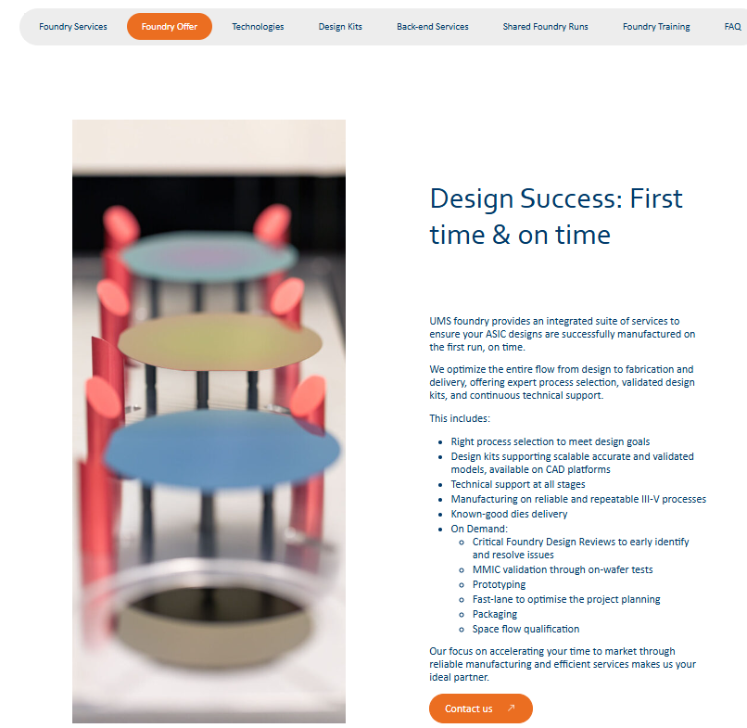

Slide 23
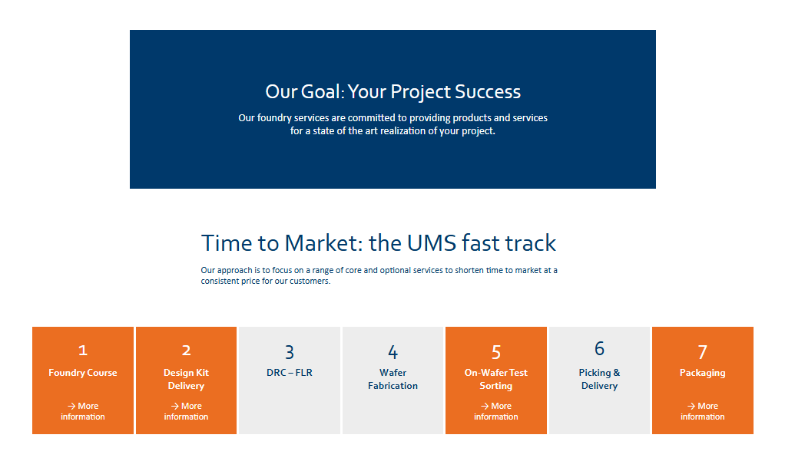

Slide 24
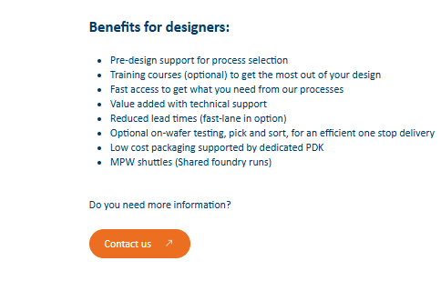

Slide 25
https://www.ums-rf.com/faq-foundry
Frequently asked questions link

Slide 26
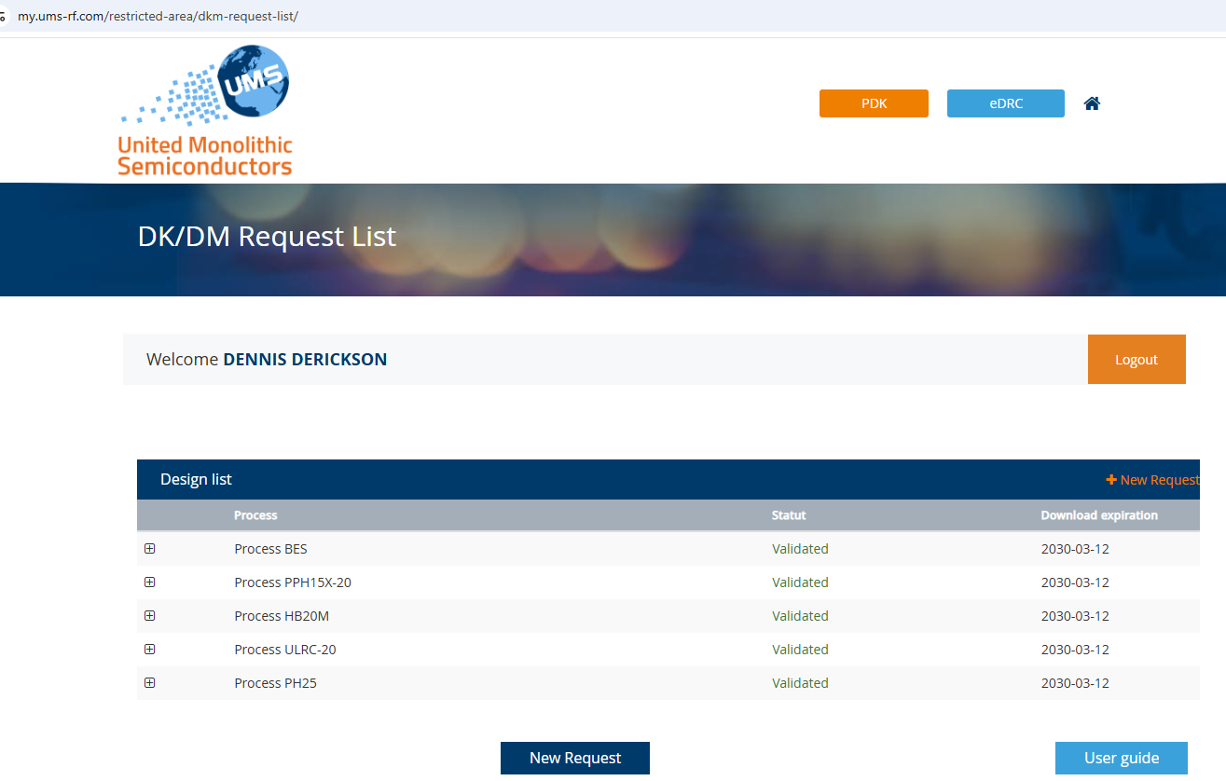

Slide 27
